Slide 1
SEO
Search Engine Optimization

Slide 2
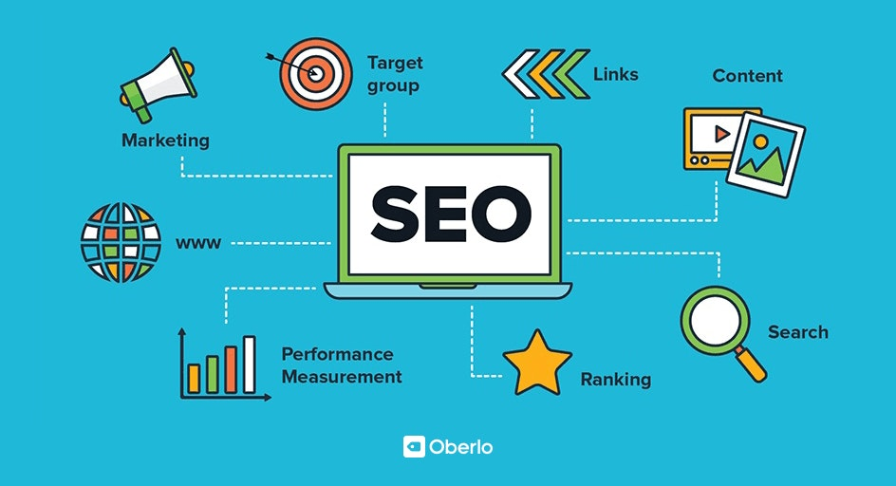
SEO
- Search Engine Optimization
SEO stands for “search engine optimization.” In simple terms, it means the process of improving your site to increase its visibility when people search for products or services related to your business in Google, Bing, and other search engines.

Slide 4






Search Engine
Google
Bing
Yahoo!
Yandex
DuckDuckGo
Baidu

Slide 5

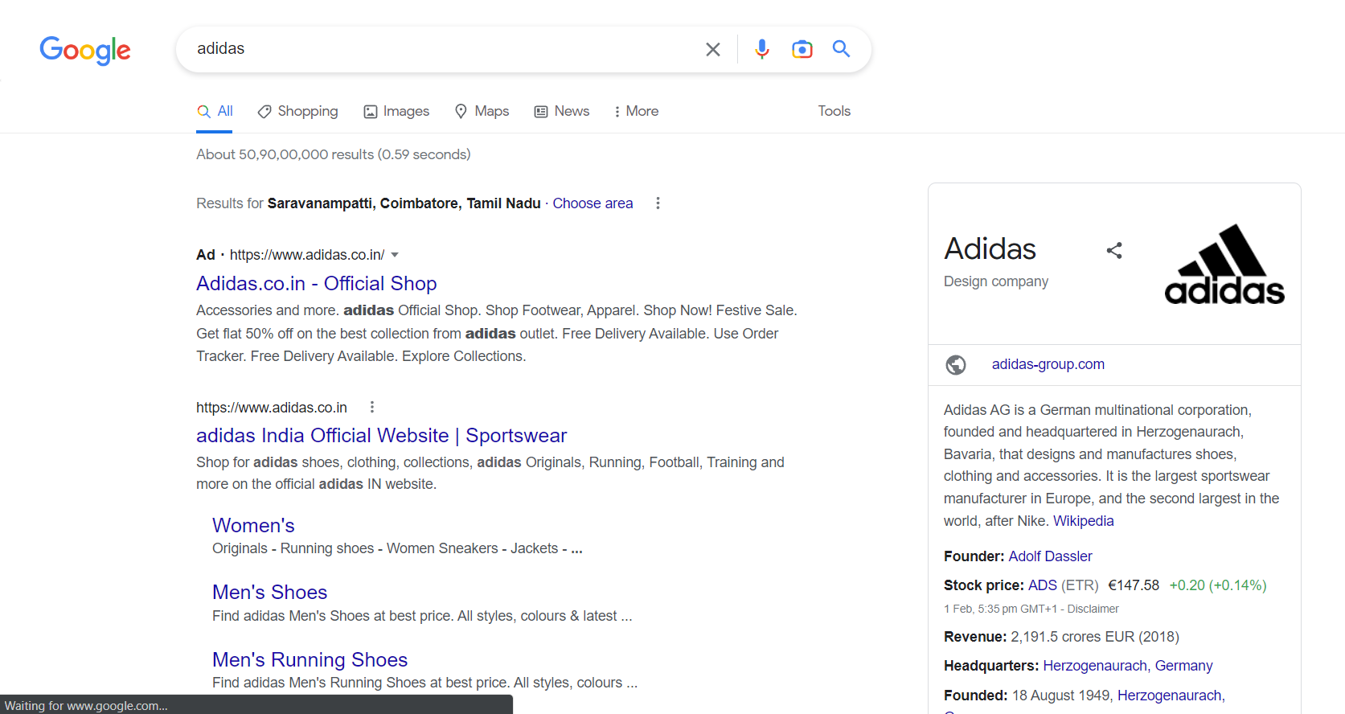
Optimized Page

Slide 6

Conclusion
Unique Content
Link Friendly Formatting
Avoid Black Hat SEO
Content relevant keywords
Market Awareness
Unique HTML page title for every landing page

Slide 7





Thank you

Slide 8


